Slide 1

Final Project Manual Testing
Mentors: Andreea Popescu
Irina Ștefan
Tester: Carmen Grigorescu

Slide 2



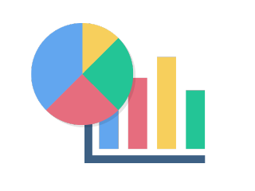







AGENDA
App Description
Testing Approach
Mindmap
Tools Used
Testing Types
Test Cases
Test results
Bugs Overview
Conclusions
Lessons Learned

Slide 3

Application Details
StarShiners.ro
Web application
Online store for women's clothing

Slide 4


Testing Approach
Testing Period: 05.01.2021 – 01.02.2021
Exploratory testing
Mindmap
Test analysis and design
Test Execution
Bug reporting
Test report

Slide 5
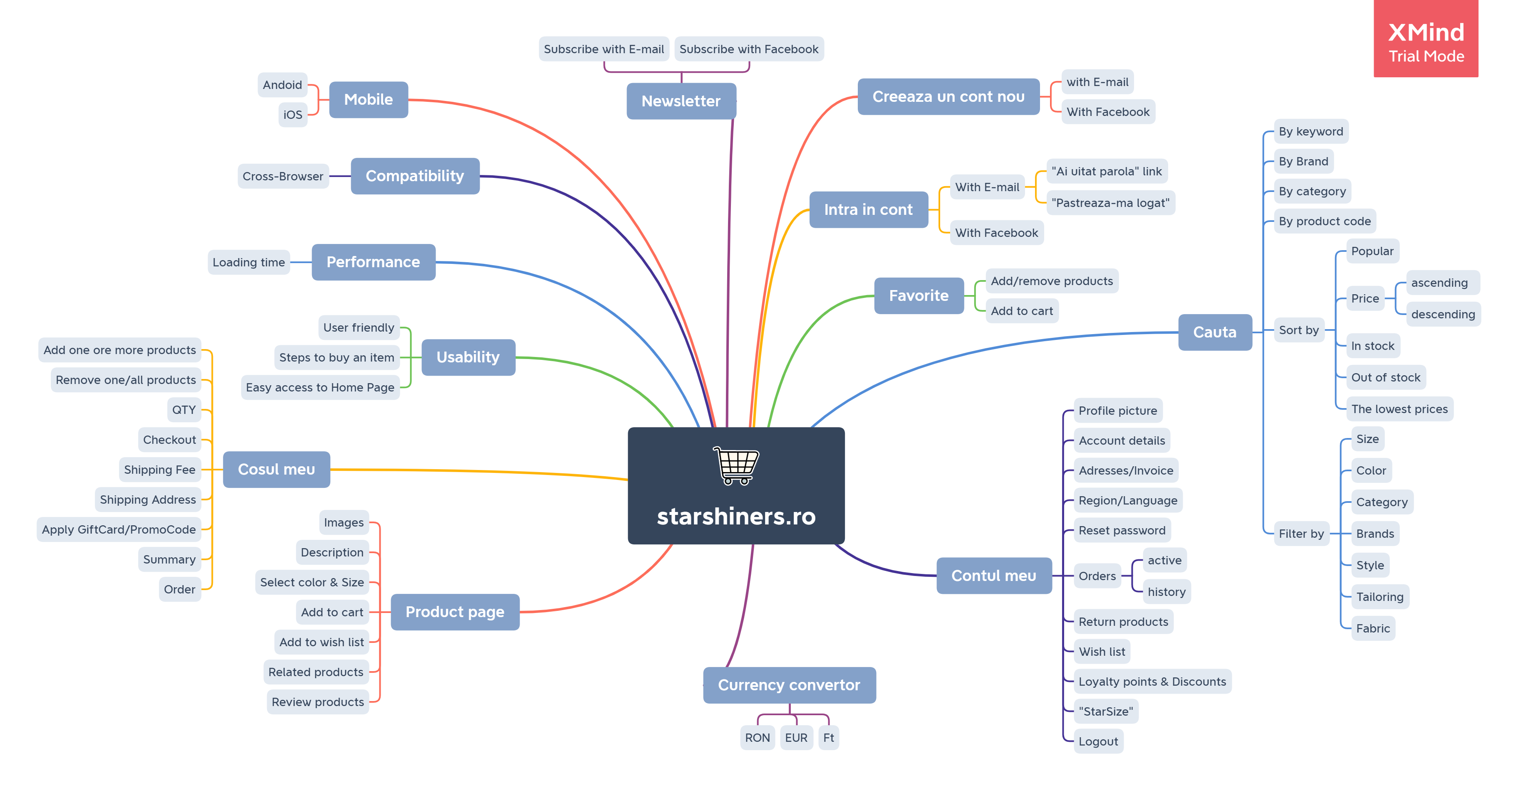
Mindmap

Slide 6








Tools used

Slide 7
Testing Types

Slide 8
Test Cases

Slide 9
Test results

Slide 10
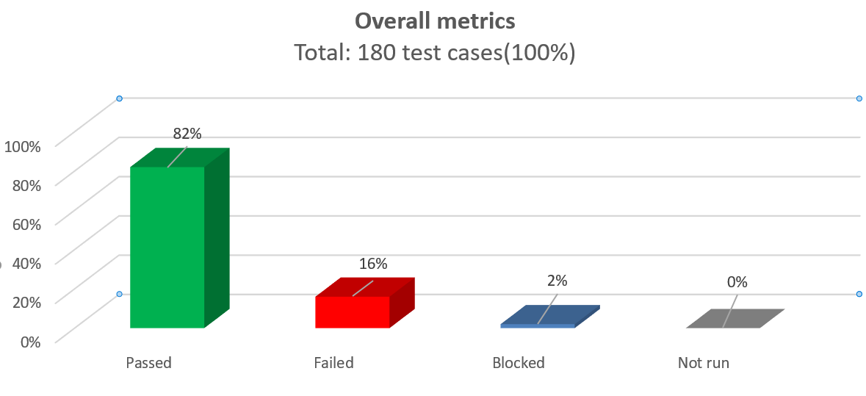
Test results

Slide 11
Bugs Overview
Bugs: 28 | Improvements: 5

Slide 12



Conclusions
Majority of bugs have minor and normal severity
The website achieves its purpose
The website looks good
Significant number of bugs in “Contul meu”, “Cosul meu, followed by “Cauta”, “Product page” and “Intra in cont”
The website is not user-friendly
Security and responsiveness issues
Performance and Security Testing is further recommended
UI & Usability improvements
Fix the major issues

Slide 13

Lessons Learned
Finding a website with sufficient amount of bugs was the main challenge
The lack of business requirements made testing more difficult
I had to clarify many things while doing the project
Testing the website took more time than I’ve previously thought and proper time management was necessary in order to finish the tasks

Slide 14


